Slide 1


ANI DE LUNA
THE UNIVERSITY OF SHEFFIELD

Slide 2
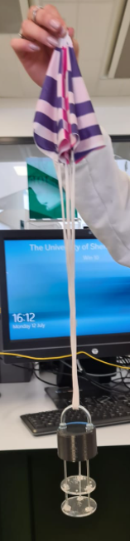
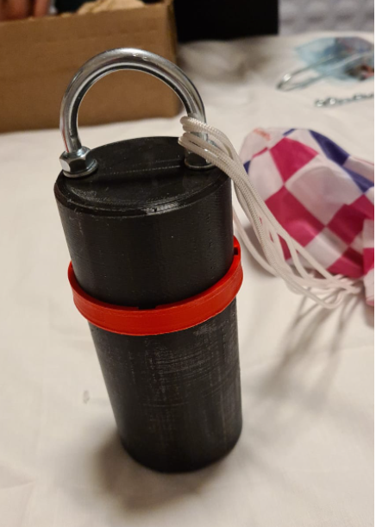
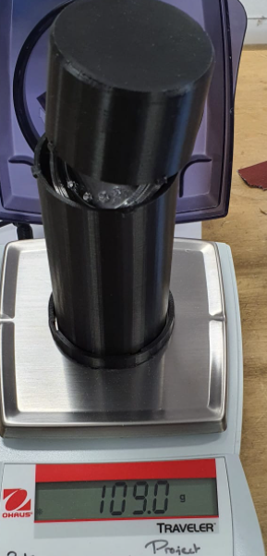
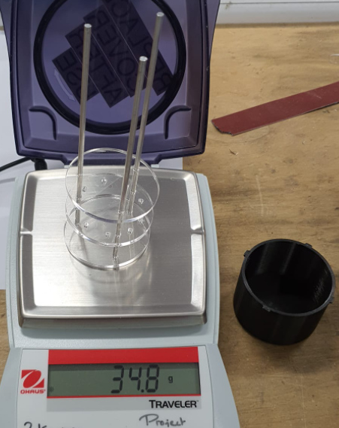
MISSION
PRESSURE, TEMPRATURE, ALTITUDE
BUZZER
PARACHUTE DEPLOYMENT

Slide 3
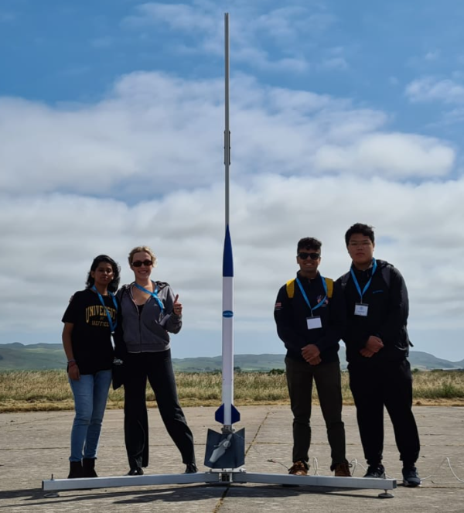
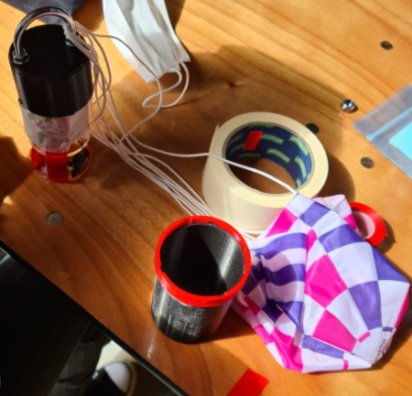
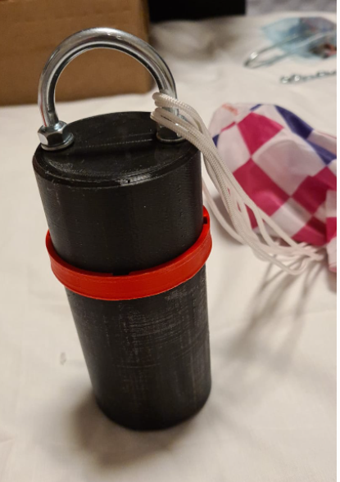
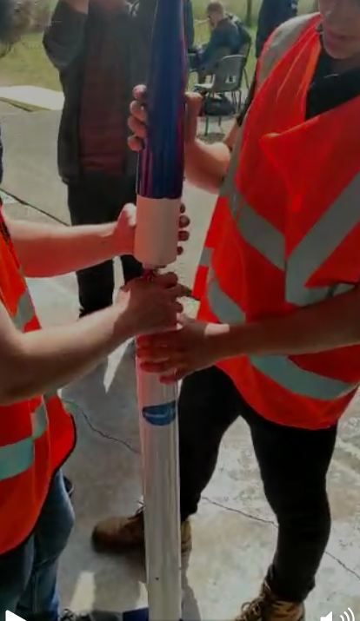
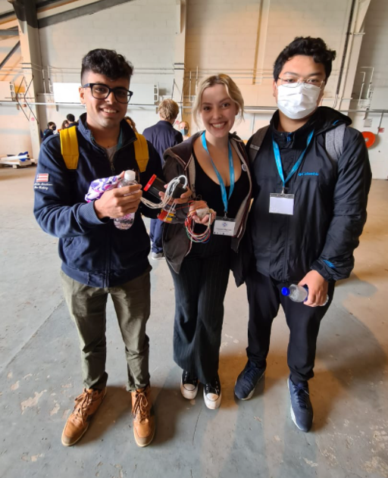
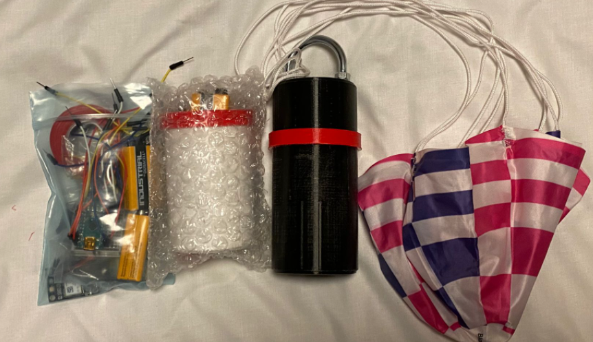
LAUNCH
STRUCTURE, PARACHUTE, CIRCUITING
COMPONENTS
PARACHUTE & MODEL CONNECTION
DID ANYTHING GO WRONG OR NOT?
We ENJOYED !!! It was a great experience !

Slide 4
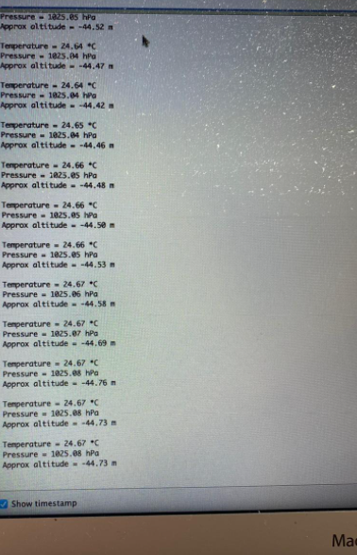
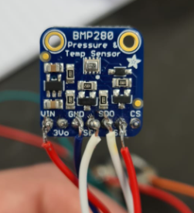
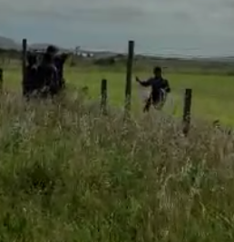
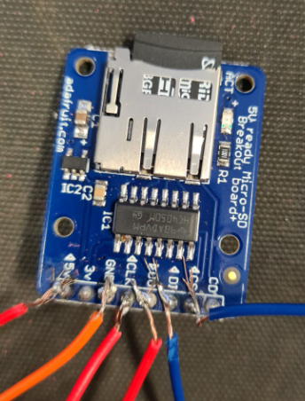
POST LAUNCH-
DATA COLLECTION
STORED IN MICRO SD CARD
DATA FOR THE PRESSURE, ALTITUDE, AND TEMPERATURE
Locating Can Sat
Offset= -44.50m
Max altitude= 294.55m
Temp= 18 (deg cel)

Slide 5
RESULTS & CONCLUSIONS
Structure- no damage, intact
Parachute- opened well and landed safe
Circuit- no damage, intact
Locating Can Sat- easily visible
Data- Estimated pressure, temperature, & altitude

Slide 6
On behalf of Ani De Luna Special Thanks
Gravitylabs
UKLSL Team
University of Sheffield
Mark Seward , Jacob Pompe
Hutheyfa

